Slide 1

Smart Flashcards
Our flashcards are better than your flashcards

Slide 2
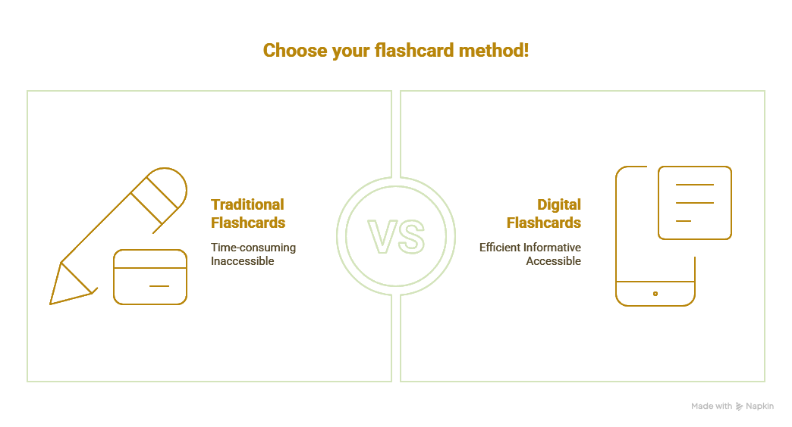
Notes:
“Have you ever spent hours writing flashcards by hand, struggled to keep them organized, and missed study time because your cards were sitting at home. Don't let traditional paper flashcards slow down your learning.
Deckster brings flashcards into the 21st century with smart technology that fits your entire study library in your pocket.

Slide 3
01
Introduction
…of the Team that Needs No Introduction

Slide 4




Teamwork Makes The Dreamwork
Jaden Szewczak
Stuart Gross
CSV Import Implementation, UI/UX Design, Theming & Styling, Accessibility, GraphQL Integration
Backend Architecture, Study Session Features, Performance Analytics, Database Design, Deployment
Antonina Stancheva
Jonathan Hummer
Frontend Development, Component Architecture, UI/UX Design, Redux Integration, Search Features
Full Stack Development, Authentication & Security, Profile Management, Team Organizer
Notes:
Jaden: Hi everyone! My name is Jaden Szewczak, and I’m from Philadelphia, Pennsylvania. I spent two years automating processes through VBA and SQL in my previous logistics role, and recently, was scouted by the tech division at my company to join their team. I accepted the role and moved to Edison, New Jersey to start the next chapter of my life. 🥳
Stuart: A dedicated software developer transitioning from a decade-long career as a full-time electrical engineer, bringing a strong analytical mindset, problem-solving skills, and a deep understanding of complex systems. With a passion for coding and a keen eye for detail, they leverage their engineering background to write efficient, scalable software solutions. Eager to contribute fresh perspectives and technical expertise, they are committed to continuous learning and innovation in the ever-evolving world of software development.
Antonina: With a degree in Finance, Antonina initially explored the world of finance, but soon discovered her passion lies in coding. As a JavaScript developer, she loves creating complex functionalities in a simple and understandable way, while also enjoying the challenge of hunting and resolving bugs.
Jonathan: Jonathan has a demonstrated history of using his computer programming skills and logic to implement automation in business processes and reporting and develop forms and applications for use in financial, supply chain, operations, customer service, and commercial functions. However, much of that programming has been done with Visual Basic/VBA in the Microsoft Office Suite. Jonathan began the Columbia University Computer Programming Bootcamp in an effort to learn new, practical programming languages with an aim to deploy stable web applications designed to help businesses achieve their goals with bespoke programming written for their needs. You can contact Jonathan using the links to the left below the AI-generated headshot.

Slide 5
02
Concept
Learning is what brings us together today
Notes:
Description & Motivation
Deckster is a modern, full-stack flashcard study application built with the MERN stack and GraphQL that transforms traditional flashcard learning through digital flashcard importing and comprehensive progress analytics.
We chose a flashcard app for the following challenges
Solid backend to handle real-time session tracking and analytics
Interactive frontend elements with smooth animations and user feedback
Responsive mobile design and accessibility
Options for features rich in user value
Make Jonathan's dream a reality

Slide 6
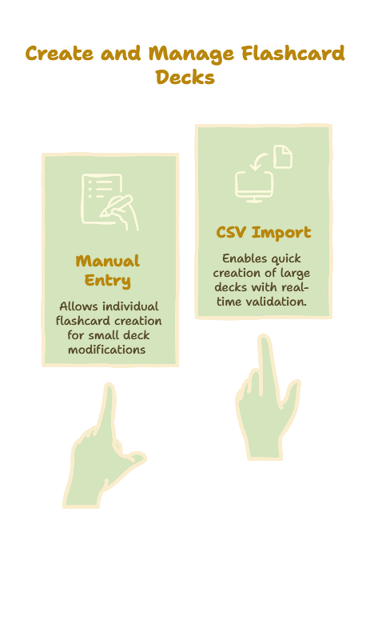
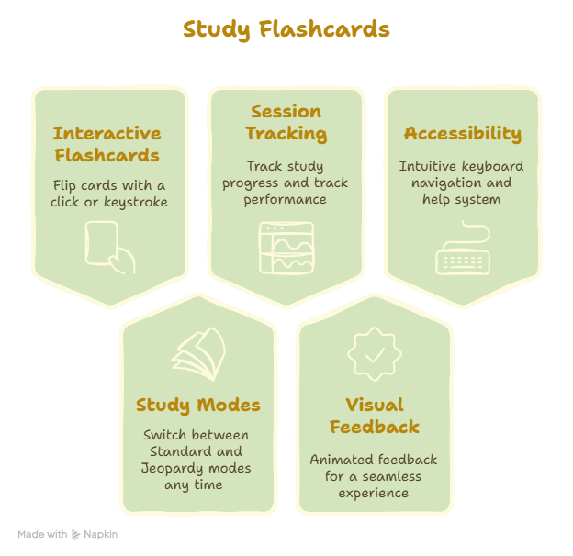
Notes:
“Have you ever spent hours writing flashcards by hand, struggled to keep them organized, and missed study time because your cards were sitting at home. Don't let traditional paper flashcards slow down your learning.
Deckster brings flashcards into the 21st century with smart technology that fits your entire study library in your pocket.

Slide 7
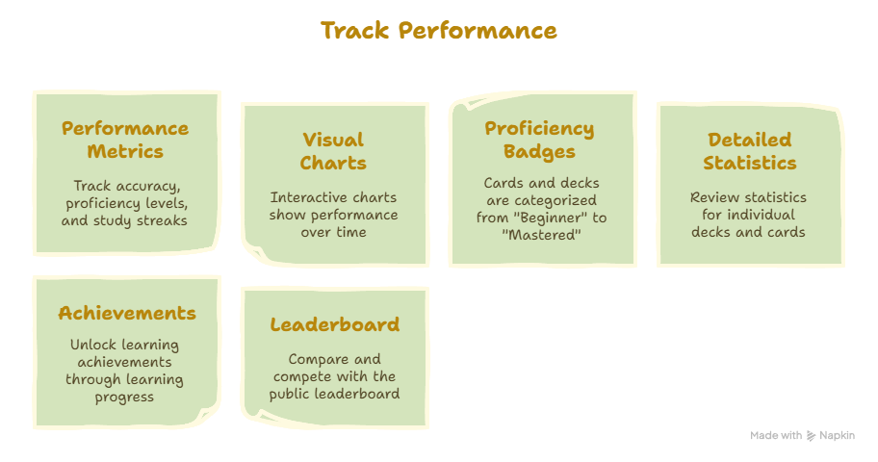
Notes:
“Have you ever spent hours writing flashcards by hand, struggled to keep them organized, and missed study time because your cards were sitting at home. Don't let traditional paper flashcards slow down your learning.
Deckster brings flashcards into the 21st century with smart technology that fits your entire study library in your pocket.

Slide 8
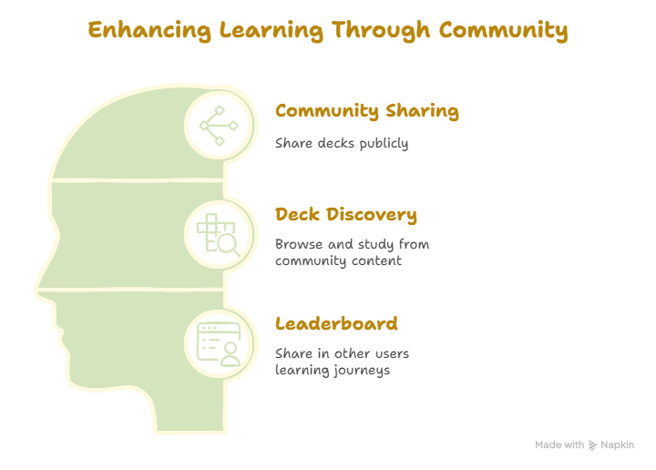
Notes:
“Have you ever spent hours writing flashcards by hand, struggled to keep them organized, and missed study time because your cards were sitting at home. Don't let traditional paper flashcards slow down your learning.
Deckster brings flashcards into the 21st century with smart technology that fits your entire study library in your pocket.

Slide 9
—B.B. King
"The beautiful thing about learning is that no one can take it away from you."

Slide 10
03
Process
How the sausage is made.

Slide 11
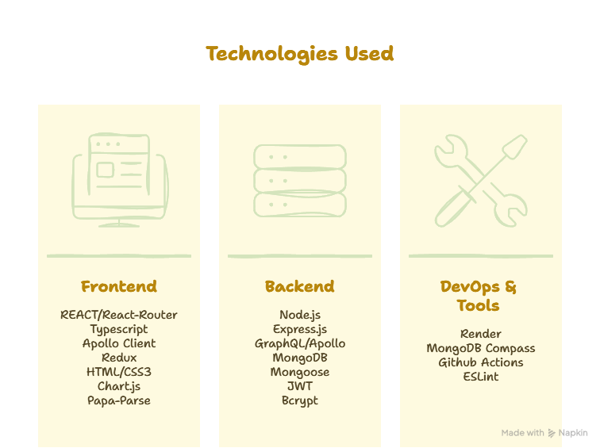
Notes:
“Have you ever spent hours writing flashcards by hand, struggled to keep them organized, and missed study time because your cards were sitting at home. Don't let traditional paper flashcards slow down your learning.
Deckster brings flashcards into the 21st century with smart technology that fits your entire study library in your pocket.

Slide 12
Challenges and Successes
Team will add and push to repo

Slide 13
04
Demo
The moment you’ve all been waiting for…

Slide 14
Let’s Git To It
Render Link Here
Github Link Here
Notes:
https://project3-cngq.onrender.com/

Slide 15
05
Future Plans
Where do we take it from here?

Slide 16
What Do We Still Need
Spaced Repetition Algorithm – Optimize review timing
Collaborative Decks – Multi-user deck editing
AI-Generated Flashcards – Create cards from documents
Voice Commands – Hands-free studying
Offline Mode – Study without internet connection
Rich Media – Audio and video flashcards
Study Groups – Share and compete with friends
Deck/Flashcard Export – Export to CSV

Slide 17
06
Questions
We know you have them.

Slide 18
Thanks!
Notes:
It’s been real.

Slide 19
Thanks!
Do you have any questions?
youremail@freepik.com
+34 654 321 432
yourwebsite.com
Please keep this slide for attribution

